Slide 1

Driver’s Drowsiness System
Batch No: B-08 Project Guide:
N. Pragathi (164G1A0568) Mr. M. Narasimhulu., MTech
K. Praneetha (164G1A0569) Assistant Professor.
B. Raveena Sai (164G1A0578)
Y. Sreedhar Jaswanth (164G1A05A1)
S. Vijay Kumar (164G1A05B7)
GitHub link:https://github.com/Pragathi568/Drivers-Drowsiness-System
Srinivasa Ramanujan Institute of Technology
Department of Computer Science & Engineering

Slide 2
Abstract
According to a study, around quarter of the motor vehicles accidents occur due to sleepiness and tiredness while driving long distances to the driver.
The main idea of this project is to develop an algorithm which ensures safety of the driver by monitoring the status of the driver’s eye from a camera and alerting him whenever necessary.

Slide 3
Existing System
The existing system detects the full face and it follows RGB colour format which takes more time to detect.
So the occurrence of accidents will be more due to the time delay.

Slide 4
Proposed System
The proposed system will process the live video by mainly focusing and detecting the status of eyes and reducing the risk of accidents by alerting the driver quickly.

Slide 5
Requirements
Software Requirements:
OS : Windows.
Python IDE : python 3.x.x
Module : OpenCV & which are needed.
Hardware Requirements:
RAM : 4GB and Higher.
Processor : Intel i3 and above.
Hard Disk : 320MB: Minimum.

Slide 6
Problem Definition
The present existing system has the problem in detecting & alerting the driver drowsiness by processing the full face in RGB colour format. The proposed method uses ‘OpenCV’, ‘NumPy’ and other packages for the detection of drowsiness by processing only the eyes which has to be mainly focused and by converting the video into “grey scale” to have a better performance.

Slide 7
Process
Step 1: Taking input from the camera.
Step 2: Detecting the eye & checking it’s status.
Step 3: If eye’s are open, Go To Step 2.
Step 4: If eye’s are closed, do.
Step 5: If drowsiness factor<Standard drowsiness factor, give alert until eye’s are opened.
Step 6: If drowsiness factor>Standard drowsiness factor, Go To Step 2.

Slide 8
Planning
TASK | DATE
Survey of project, Collecting the requirements & installing the packages and software needed for development. | 15-jan-2020 to 27-jan-2020.
Modelling, Creating a model to detect the eye & training it. | 28-jan-2020 to 05-feb-2020.
Building the final model and training neural network. | 05-feb-2020 to 10-mar-2020.
Execution, Testing and Debugging. | 05-mar-2020 to 26-mar-2020.
Documentation & Verification of project. | 27-mar-2020 to 02-apr-2020.
Submission of project. | 06-apr-2020.

Slide 9
Literature Survey
[1] A Survey on Driver’s Drowsiness and Unconsciousness Detection Methodologies.
The drowsiness detection systems encourages the researchers to explore more driving support in several aspects.
Driving support system to detect and alert the driver’s drowsiness and unconsciousness to avoid accidents to the vehicle and injuries to the passengers.
Computerized tracking gives good results.
N.Mathiarasi, T.Sureshkumar,”A Survey on Driver’s Drowsiness and Unconsciousness Detection Methodologies ”, in International Journal of Engineering Development and Research,2014.

Slide 10
Contd…
[2]Survey on Driver’s Drowsiness Detection System.
Drowsiness is one of the major causes behind road accidents.
It introduces a new approach towards detection of driver's drowsiness based on yawning measurement and head movement.
Therefore, the use of an assistive system that monitor a driver’s level of vigilance and alert the driver in case of drowsiness can be significant in the prevention of accidents.
Dr. Amitabh Wahi, Prof. S. Sundaramurthy, Ms. P. Abinaya,”A Survey on Automatic Drowsy Driver Detection System in Image Processing ”, in International Journal Of Innovative Science And Applied Engineering Research (IJISAER),2014.

Slide 11
Contd…
[3].A Survey on Automatic Drowsy Driver Detection System in Image Processing.
The occurrence of vehicle accidents has also seen an increase.
A detailed analysis shows that, around half million accidents occur in a year, in India alone.
Drowsiness and sleeping while driving are now identified as one of the reasons behind fatal crashes and highway accidents caused by drivers.
This uses various images of driver to detect drowsiness states using his/her eyes states, facial expressions and head poses.
Omkar Dharmadhikari , Revati Bhor , PranjalMahajan, H.V. Kumbhar,” Survey on Driver’s Drowsiness Detection System”, International Journal of Computer Applications (0975 – 8887)Volume 132 – No.5, December 2015

Slide 12
References
[1] N.Mathiarasi, T.Sureshkumar,”A Survey on Driver’s Drowsiness and Unconsciousness Detection Methodologies”,in International Journal of Engineering Development and Research,2014.
[2] Dr. Amitabh Wahi, Prof. S. Sundaramurthy, Ms P. Abinaya,”A Survey on Automatic Drowsy Driver Detection System in Image Processing”, in International Journal Of Innovative Science And Applied Engineering Research (IJISAER),2014.
[3] Omkar Dharmadhikari,Revati Bhor,Pranjal Mahajan,H.V. Kumbhar,”Survey on Driver’s Drowsiness Detection System”, International Journal of Computer Applications (0975 – 8887)Volume 132 – No.5, December 2015.

Slide 13
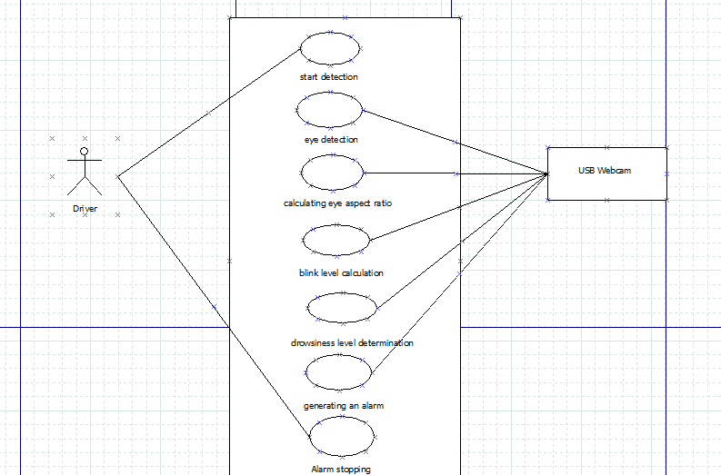
UML Diagrams Use case Diagram

Slide 14
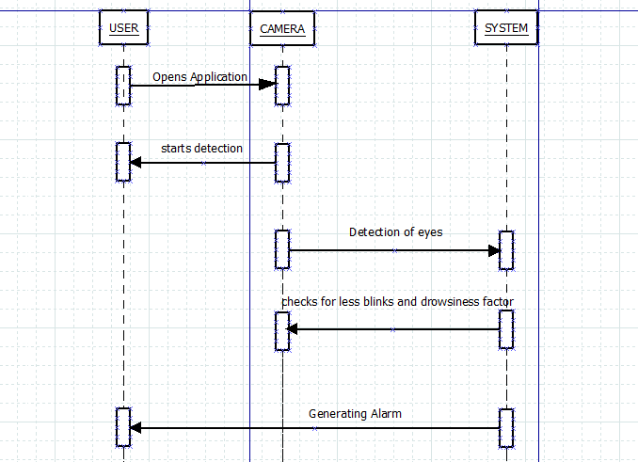
Contd..
Sequence Diagram

Slide 15
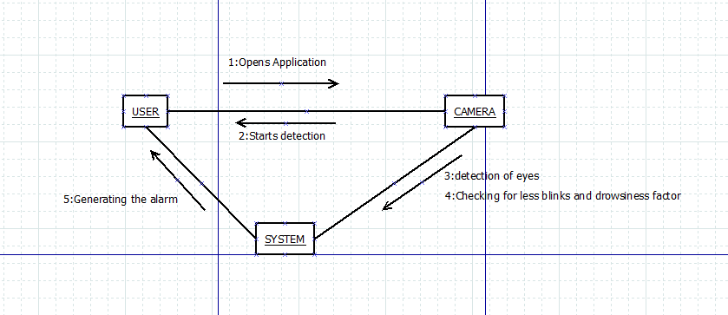
Contd..
Collaboration Diagram

Slide 16
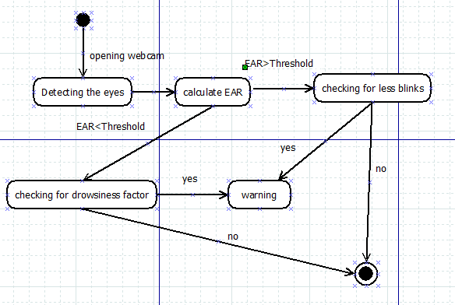
Contd..
State Diagram

Slide 17
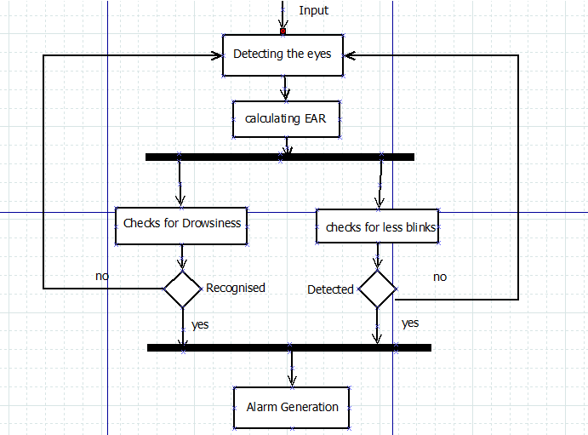
Data Flow Diagram

Slide 18
Implementation
Check the availability of webcam.
Running the code.
After detection of eye, calculation of eye aspect ratio is made, along with the blink code.
As the first stage of alerting, if the blink count is less than the threshold value it alerts.
As the second stage of altering, It checks for Eye Aspect Ratio, if it is less than the drowsiness factor the alert takes places simultaneously.

Slide 19
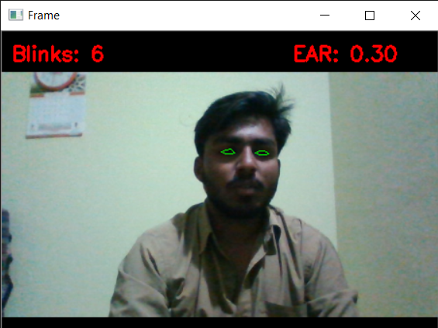
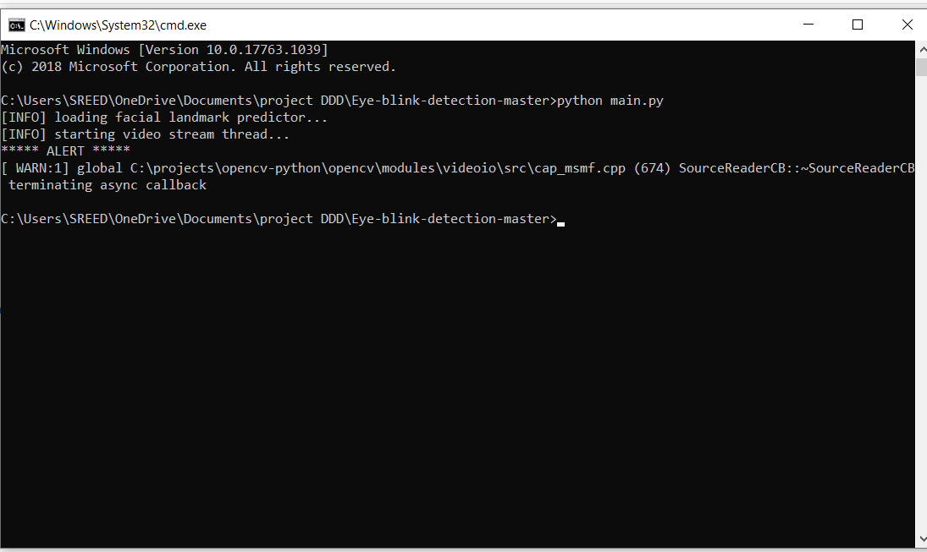
Contd..
The first stage of alerting will be like:

Slide 20
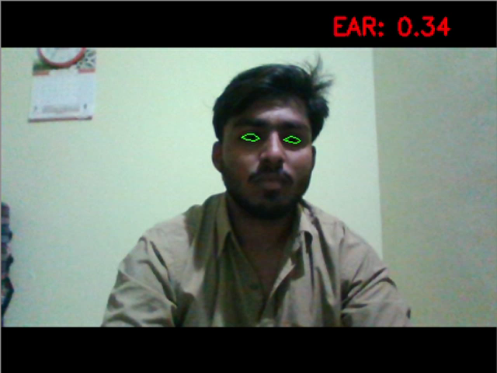
Contd..
The second of alert be like

Slide 21
Thank you
Queries
?

